Slide 1
Brots, and where to find them
By Keenan Leverty & Alex Stolzman

Slide 2
Revised Goal
Initial Goal
Using Volumetric shading to render the Julia function of the Mandelbrot set, aka the Mandelbulb using point rendering and voxels.
2D Interactive Mandelbrot
Generated on a quad

Slide 3
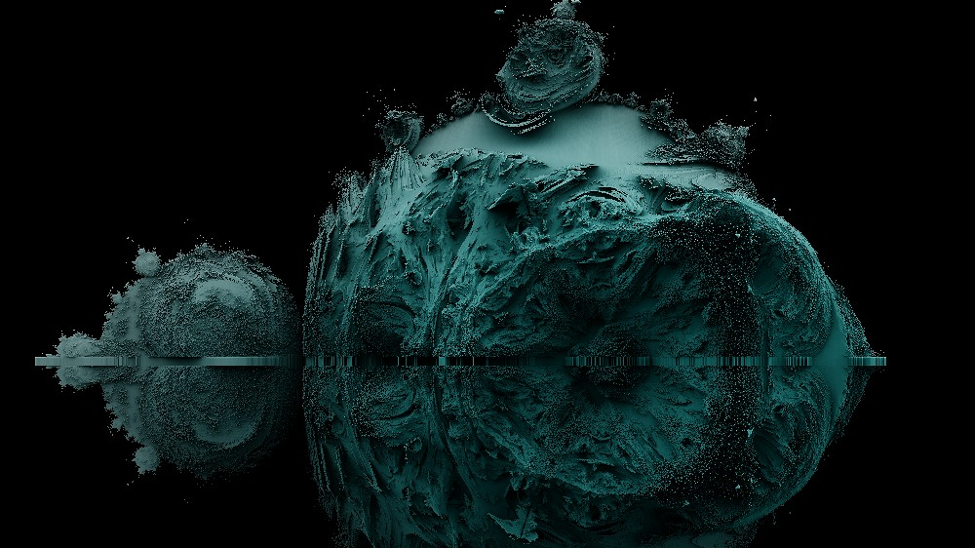
The scope
n = 2

Slide 4
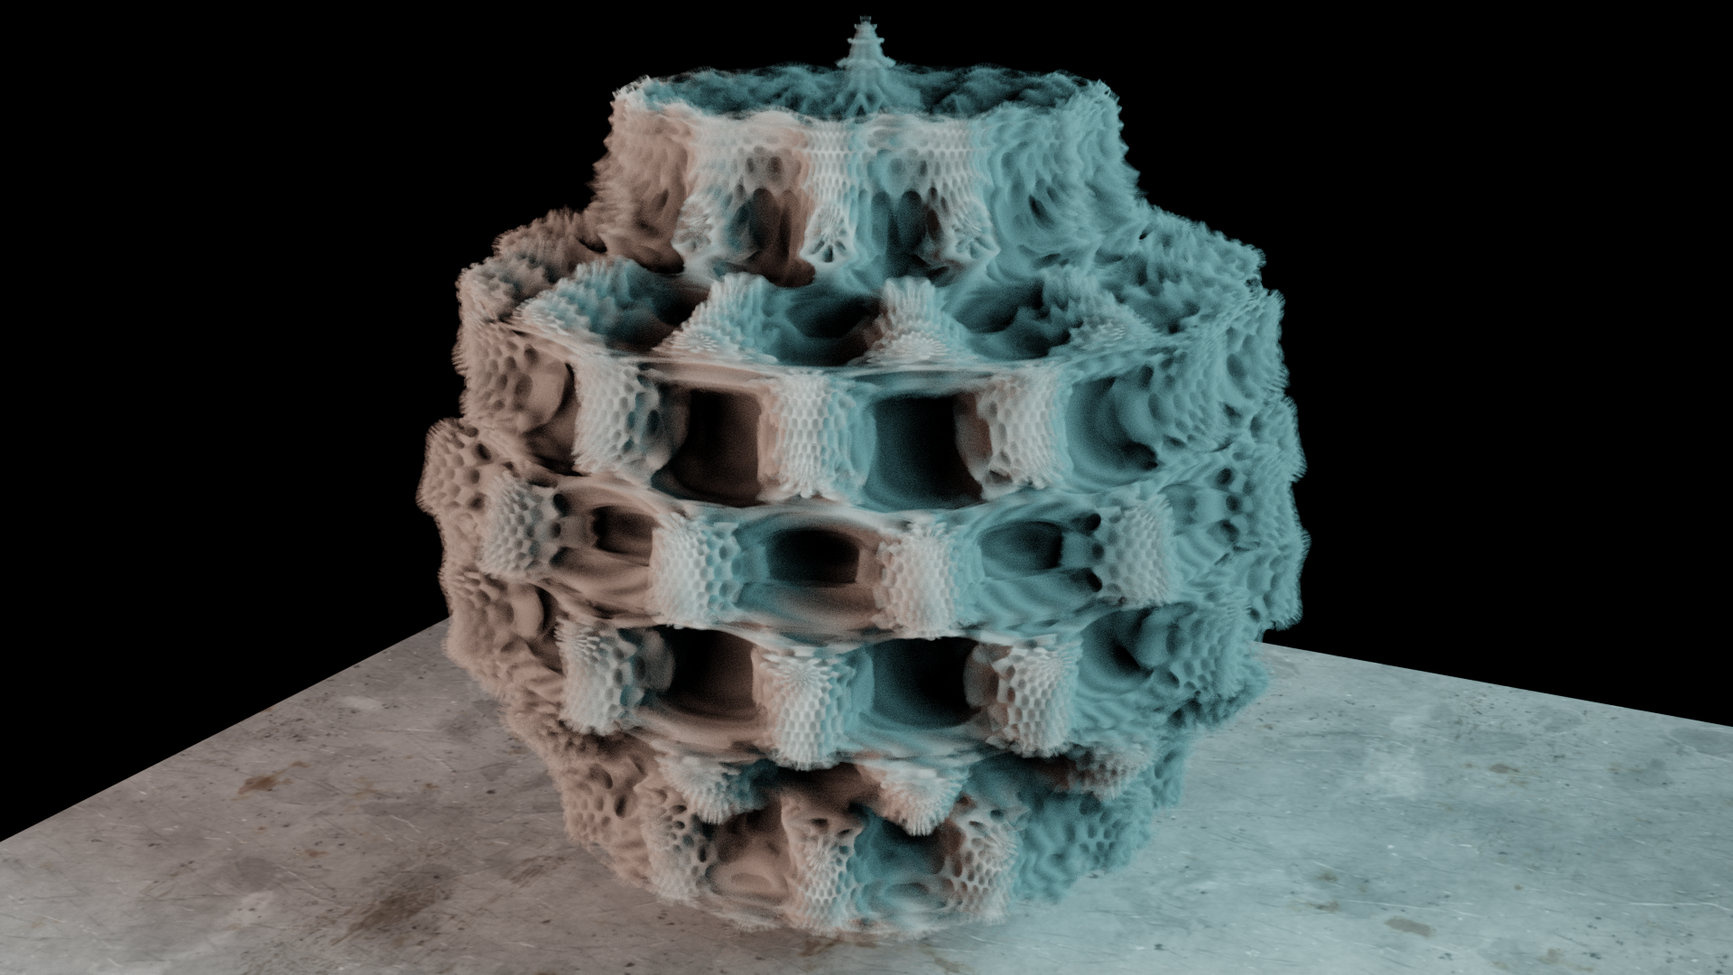
n = 8

Slide 5
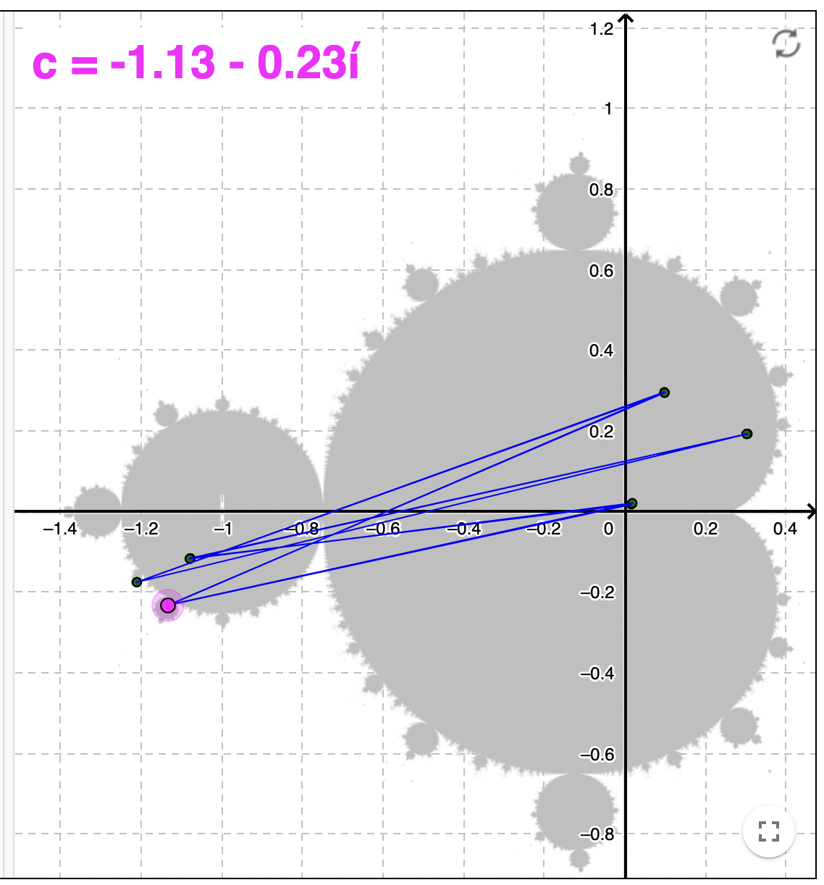
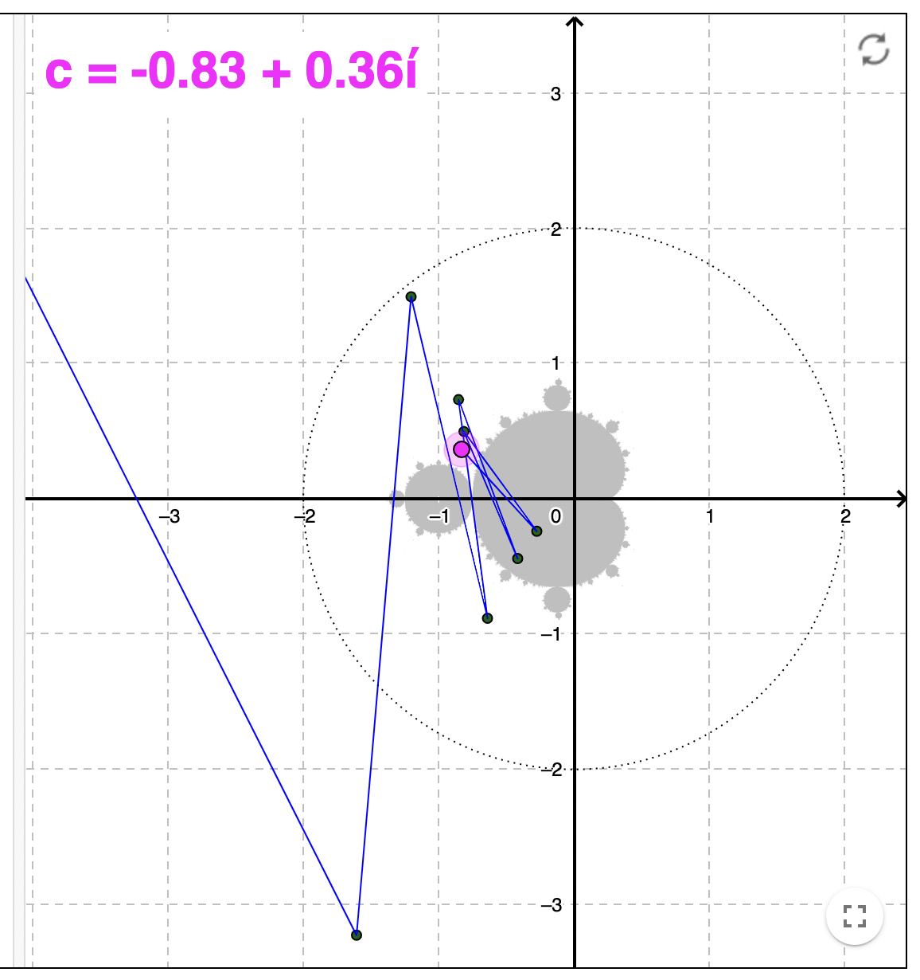
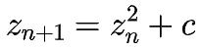
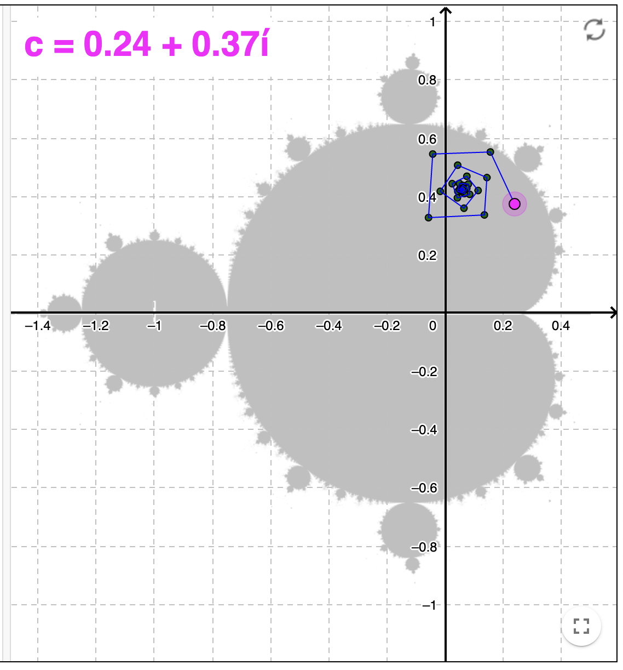
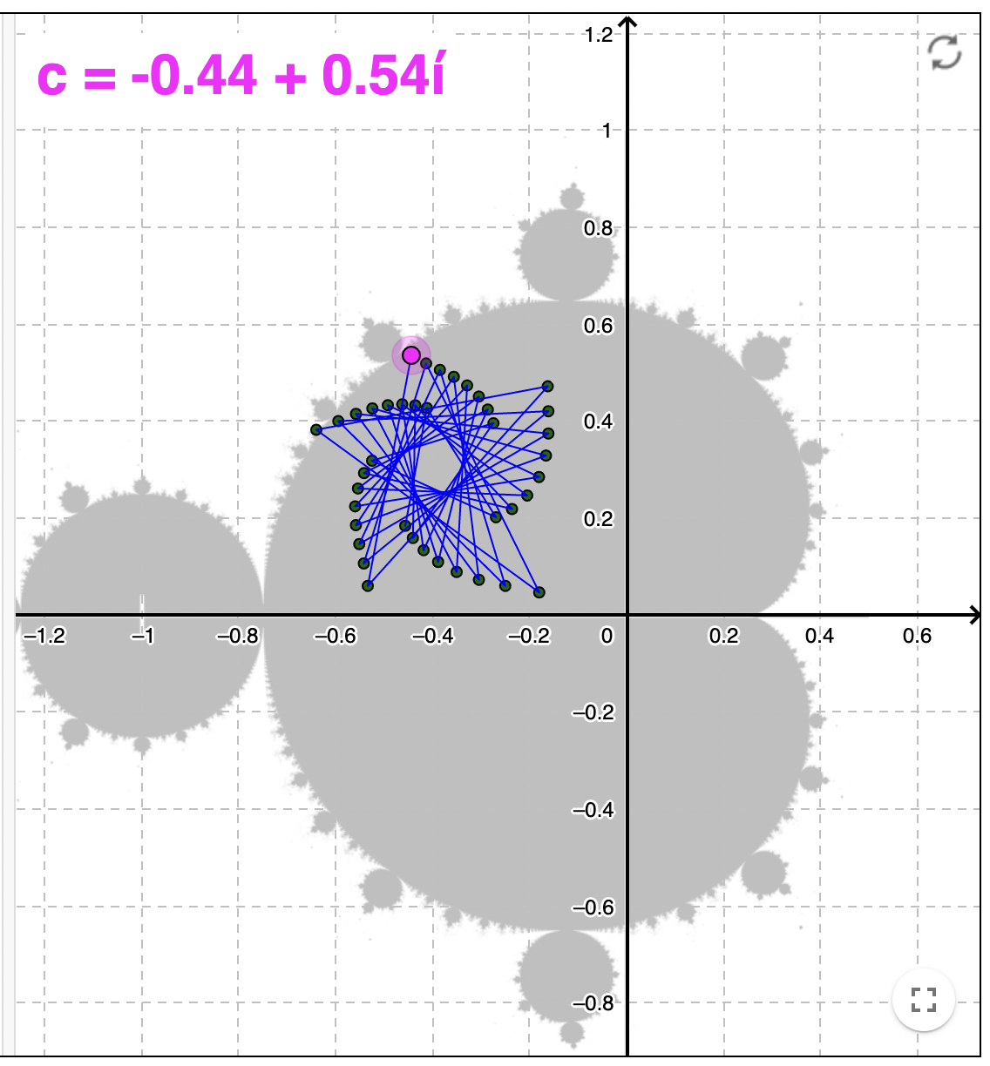
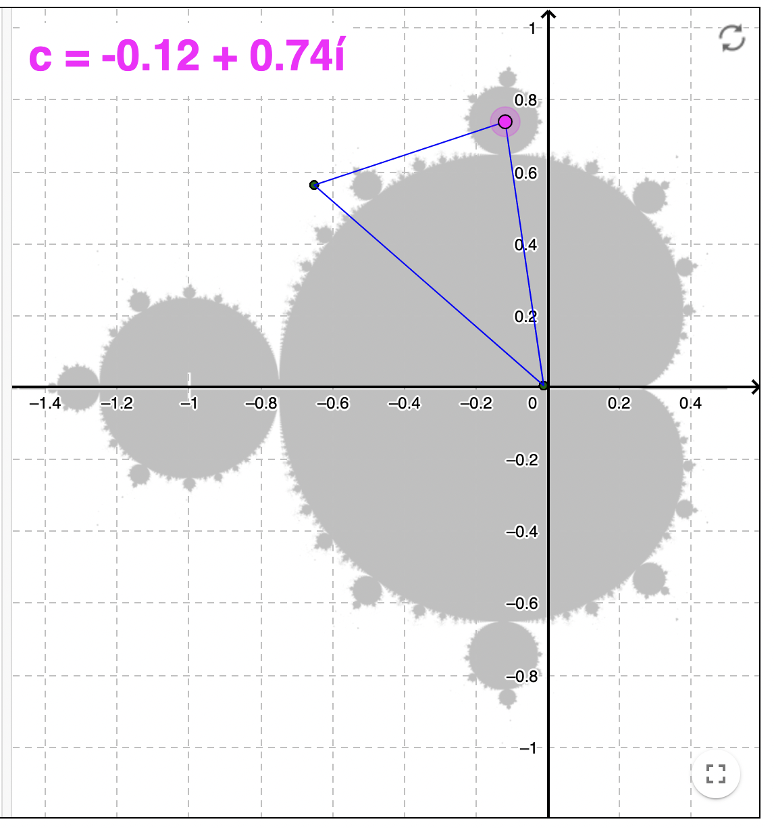
But how?

Slide 6
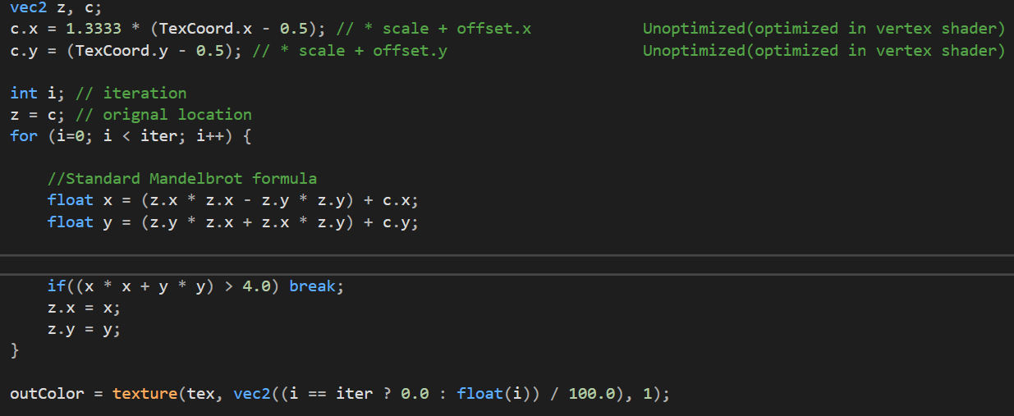
Mandelbrot Formula

Slide 7
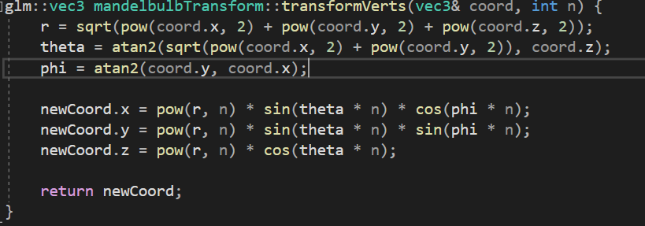
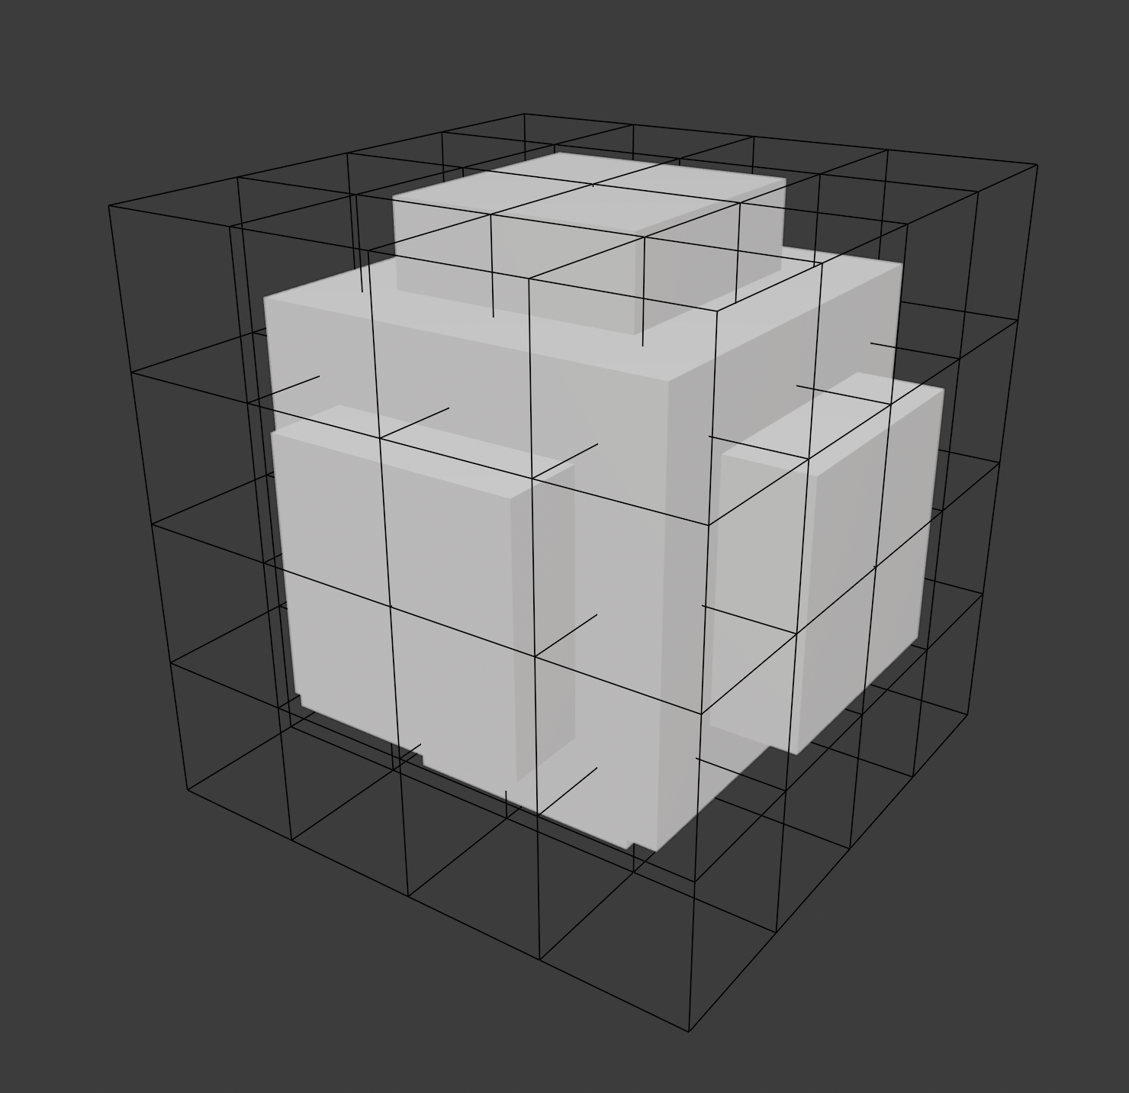
Initial Plan
Use a lattice of meshes which could be ignored when rendering, depending on if they were in the set or not.
Adjust resolution for more detail.

Slide 8
Optimization
Initial Plan: Implement Culling and dynamic LOD depending on how far you are from the shading points of the Mandelbulb.
Revised Plan: Moved texcoords from frag shader to vert shader, MAD,

Slide 9
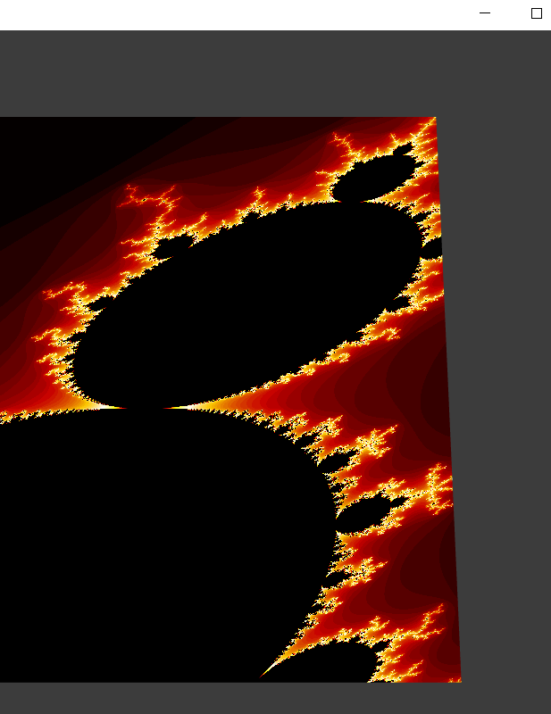
The result
Mandelbrot set with camera controls
Generated on a quad, coloring is generated using a palette texture

Slide 10
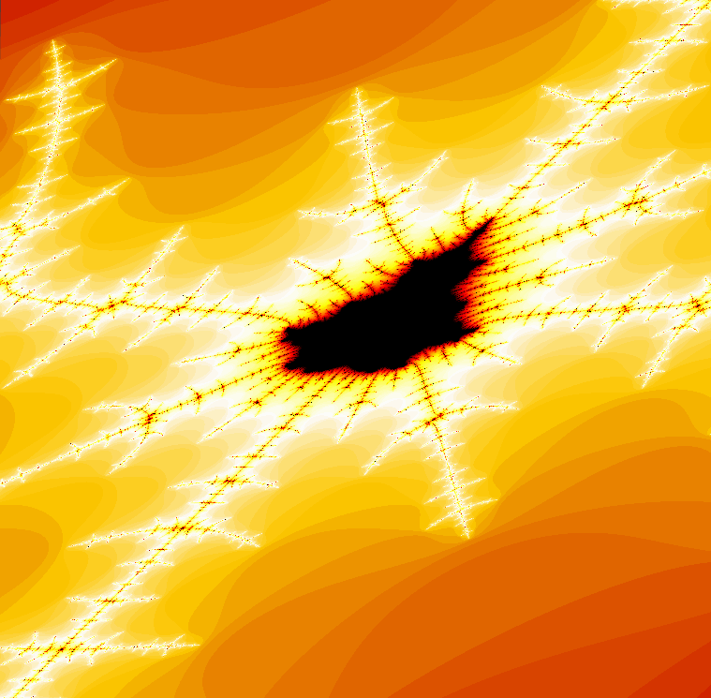
Zoomed in

Slide 11
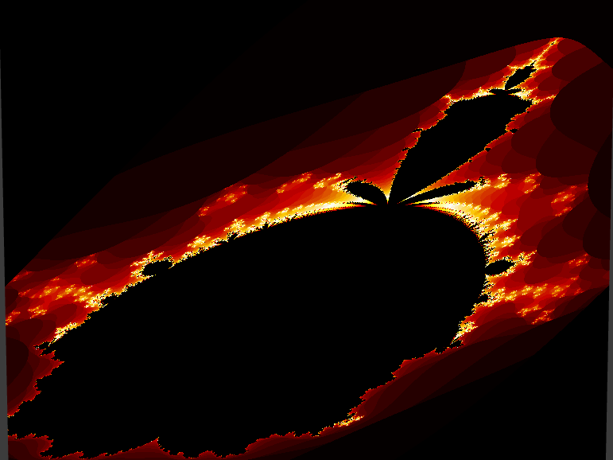
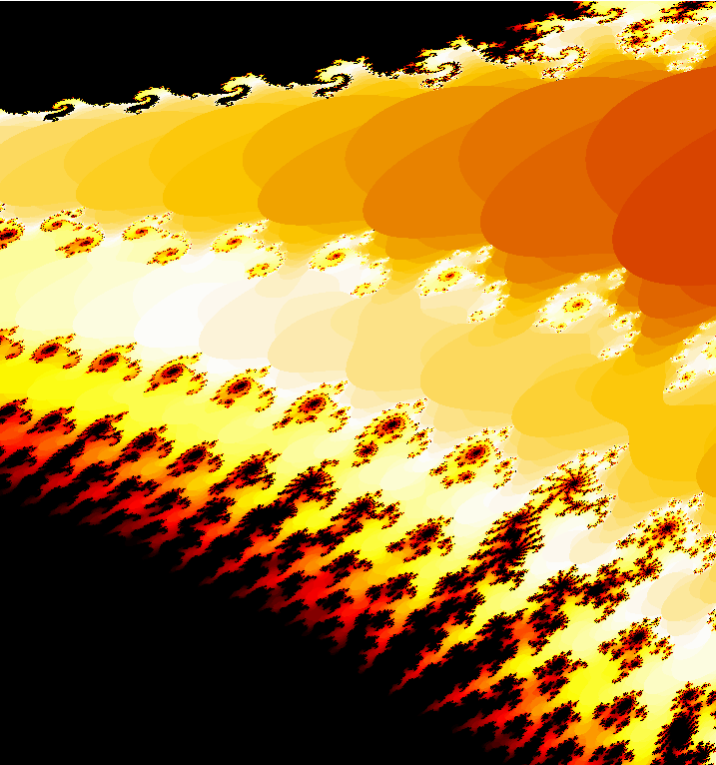

Slide 12
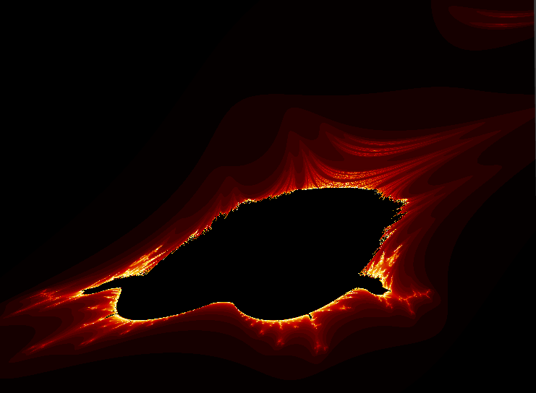
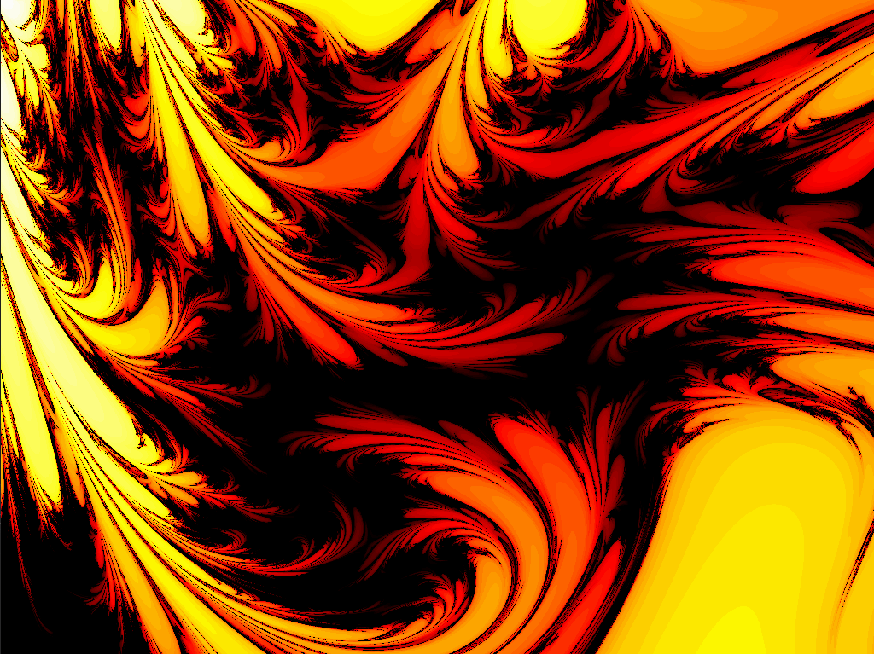

Slide 13
Thank you!

